Slide 1
Nematode.net: A Community Resource for Nematologists

Slide 2
Introduction
Nematode.net origins in 2000
Community resource
  Transcript data
  Protein families (NemFams)
  Comparative genomics tools
  Expression data
  Nematode genomes
Growth over the years
  Volume of data
  Types of data
    Sanger ESTs, 454 cDNA, CDS from complete genomes, Illumina RNAseq (coming soon)
  Breadth of analysis
    Drug targeting,Comparative pathway analysis, Stage-specific expression data & more
Follow us on Twitter @nematodenet
1
http://nematode.net

Slide 3
Outline of Talk
Data Navigation
  Description of the 3 ‘entry-portals’
Site Overview
  Description of the site in detail, including how to use the various tools
Hosted Datasets
  Description of the resources hosted on the site
Upcoming Projects
2
http://nematode.net

Slide 4
Data Navigation: On-Ramps
Organism-Centric Portals
  Use these portals if you are interested in browsing all the various resources available for a specific species
  Select your organism of interest using the expandable menu along the left side of each page
  From the presented species hub, resources can be jumped into using provided links
Data-Mining Portals
  Use these portals to explore specific datasets hosted within Nematode.net
  These portals provide the means to find & display subsets of large datasets, as well as download data in bulk
Data Analysis & Comparative Genomics Portals
  These portals allow users to make complex queries of specific datasets, or provide comparative views between datasets
3
http://nematode.net

Slide 5
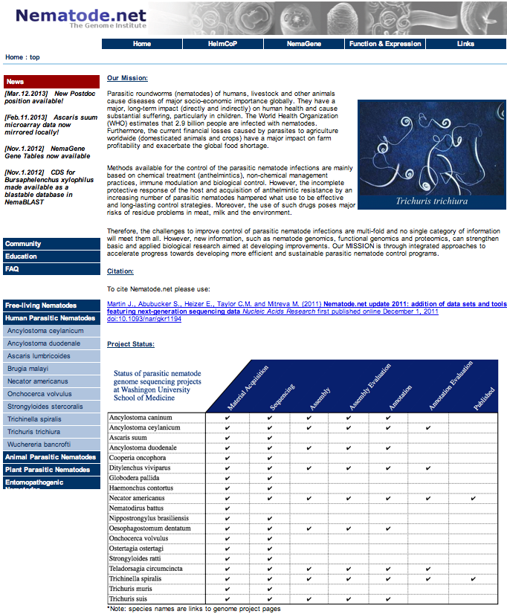
Data Navigation: Organism-Centric Portals
Species
Hub
Menu
4
http://nematode.net

Slide 6
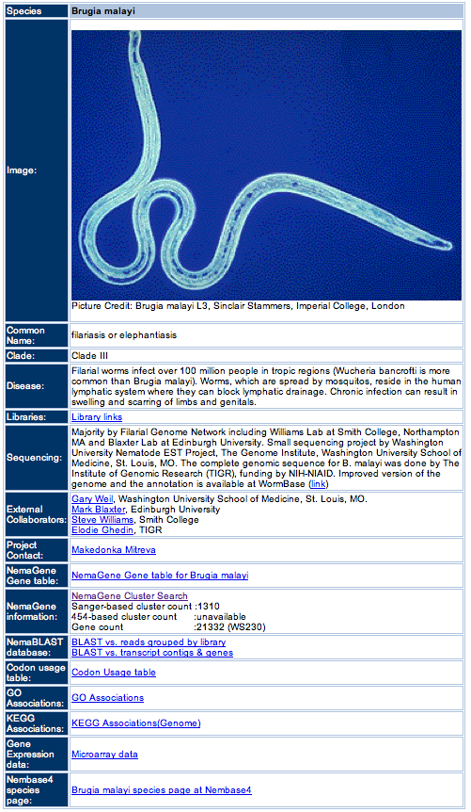
Data Navigation: Species Hubs
5
http://nematode.net

Slide 7




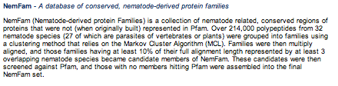
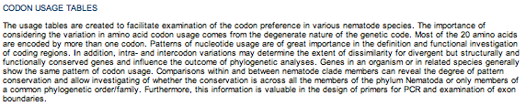

Data Navigation: Data-Mining Portals
6
http://nematode.net

Slide 8
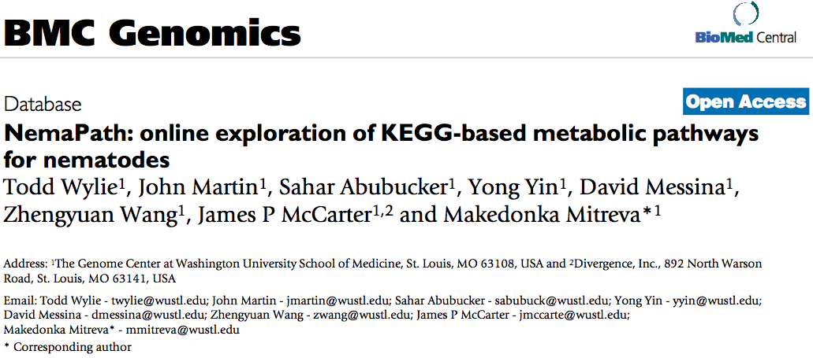
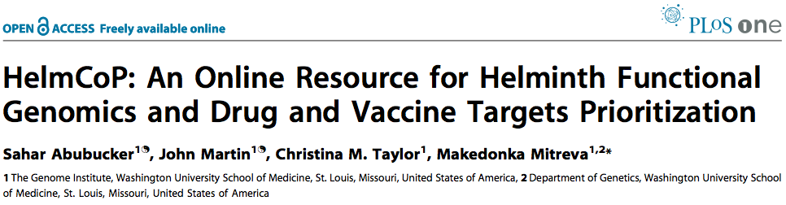
Data Navigation: Data Analysis & Comparative Genomics Portals
7
http://nematode.net

Slide 9
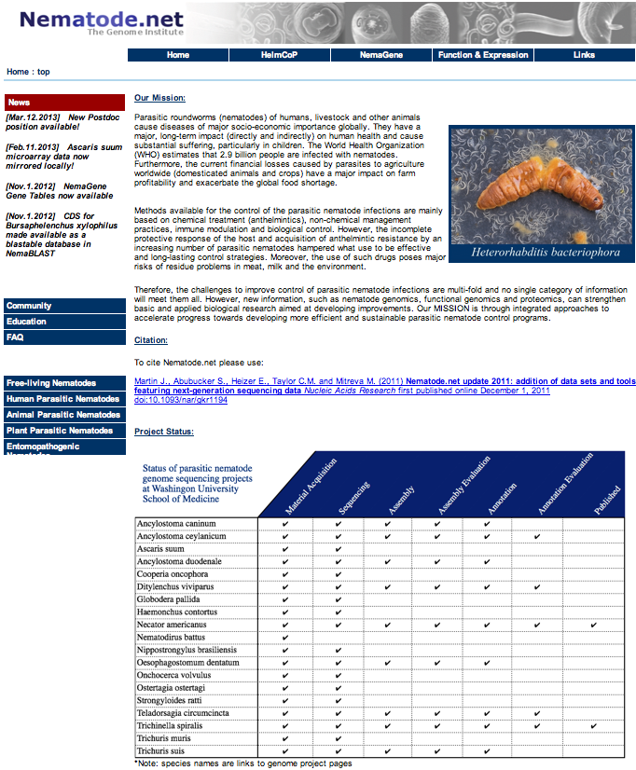
Site Overview: Home Page
Analysis Navigation Menus
News
Banner
Community
Resources
Nematode.net
Citation
Species
Hub
Menus
Project
Status
8
http://nematode.net

Slide 10
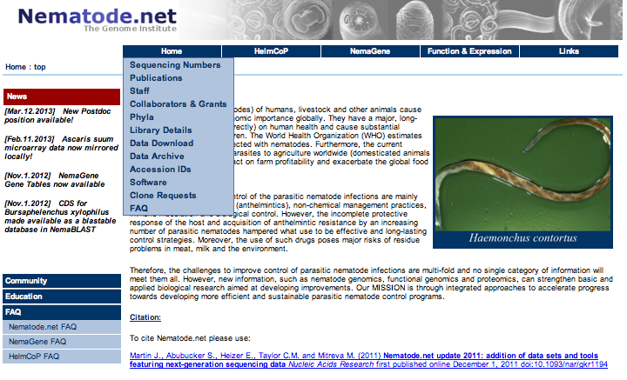
Site Overview: Home Menu
9
http://nematode.net

Slide 11
Site Overview: Species Hub
10
http://nematode.net

Slide 12
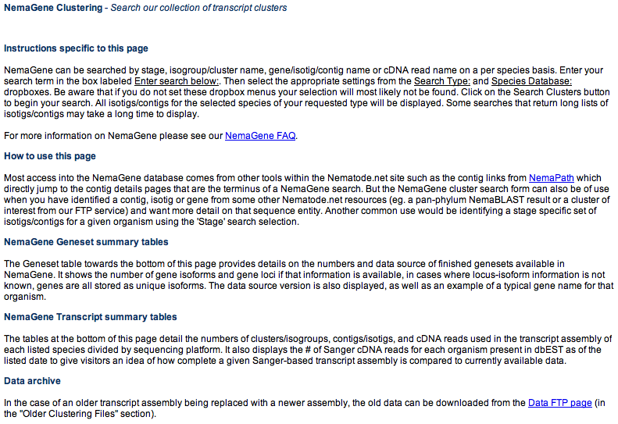
Site Overview: NemaGene Cluster Search
11
http://nematode.net

Slide 13
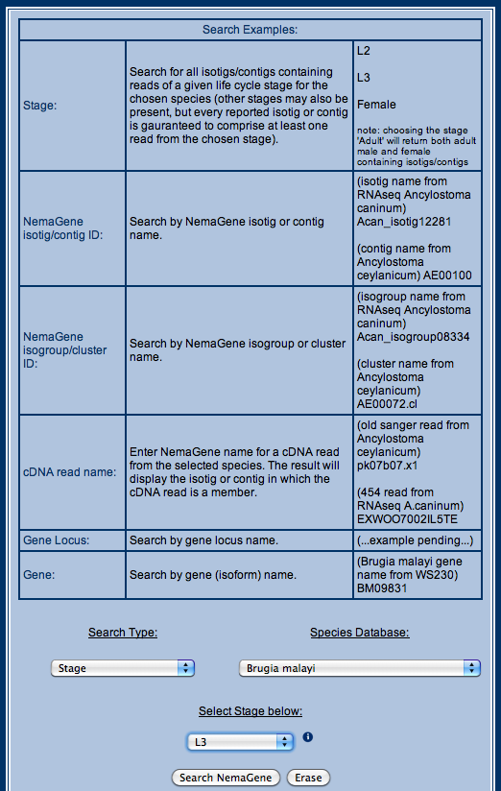
Site Overview: NemaGene Cluster Search Interface
12
http://nematode.net

Slide 14
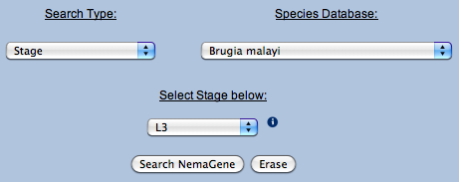
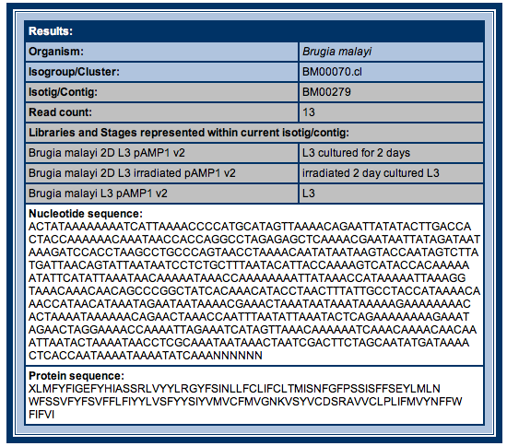
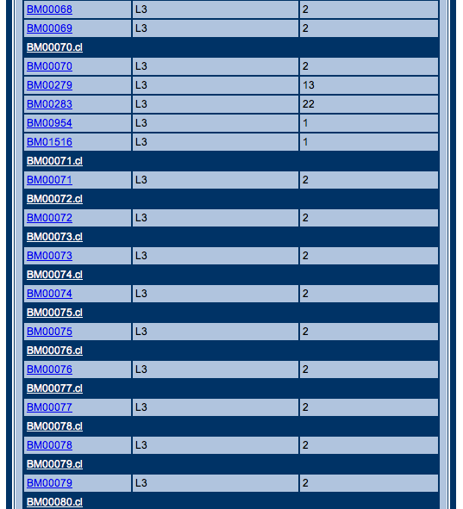
Site Overview: Querying NemaGene Clusters
Enter
Query
Information
Display
Select Cluster
or Contig to view
13
http://nematode.net

Slide 15
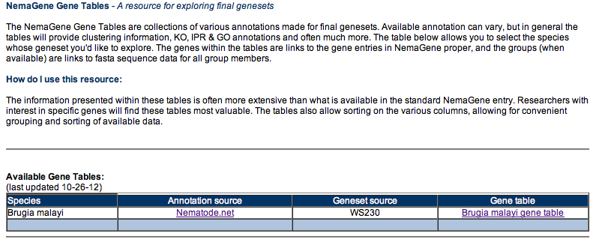
Site Overview: NemaGene Gene Table
14
http://nematode.net

Slide 16
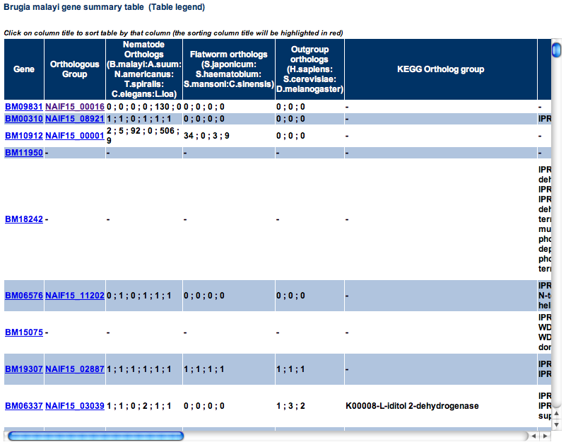
Site Overview: NemaGene Gene Table Data
15
http://nematode.net

Slide 17
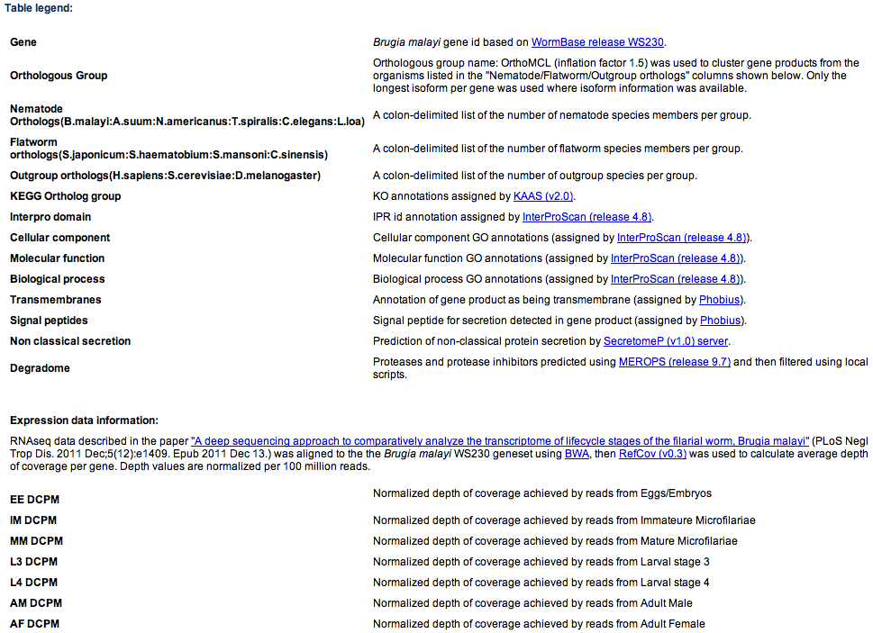
Site Overview: NemaGene Gene Table Legend
16
http://nematode.net

Slide 18
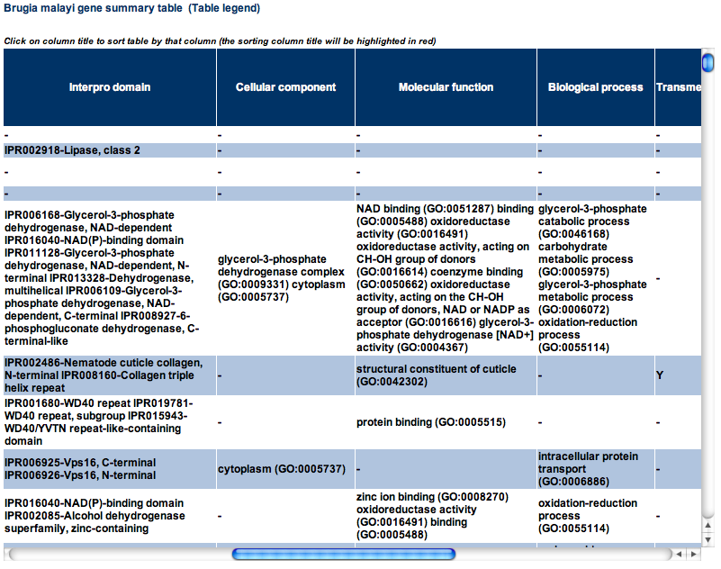
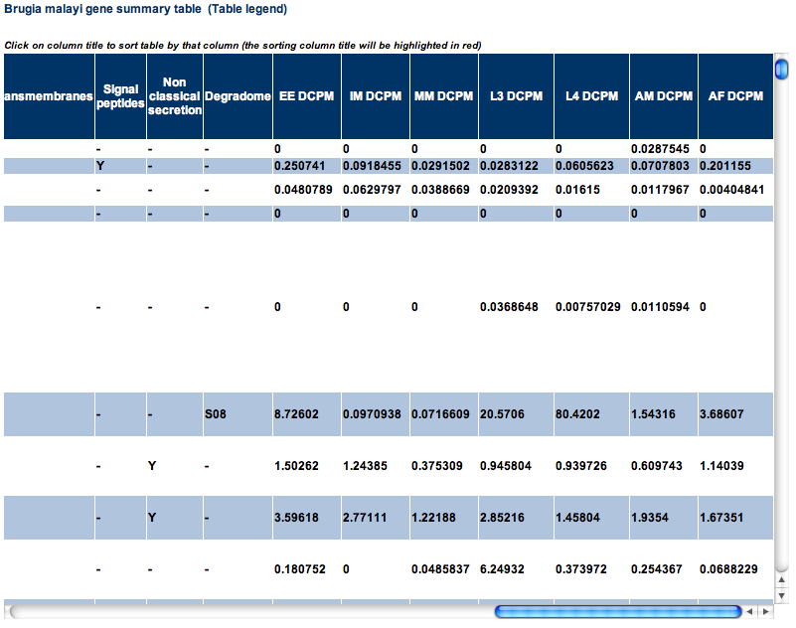
Site Overview: NemaGene Gene Table Display
Data spans roughly 3 page widths
17
http://nematode.net

Slide 19
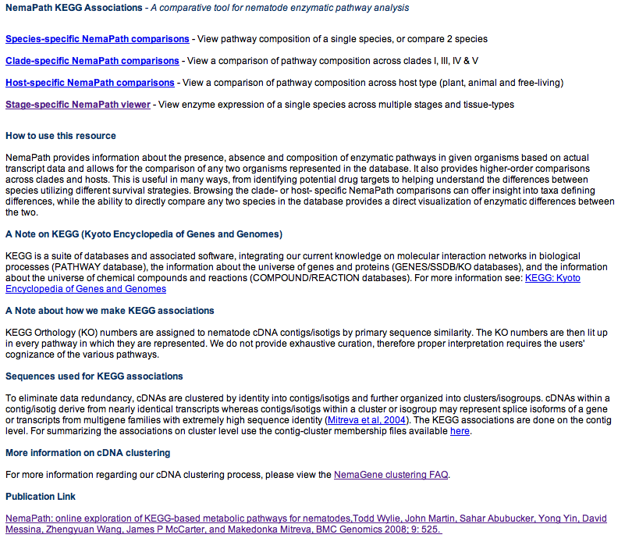
Site Overview: NemaPath
18
http://nematode.net

Slide 20
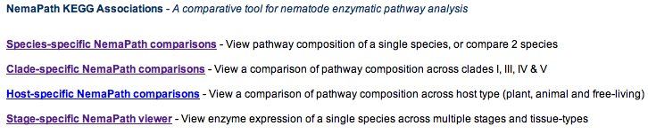
Site Overview: NemaPath View Selection
19
http://nematode.net

Slide 21
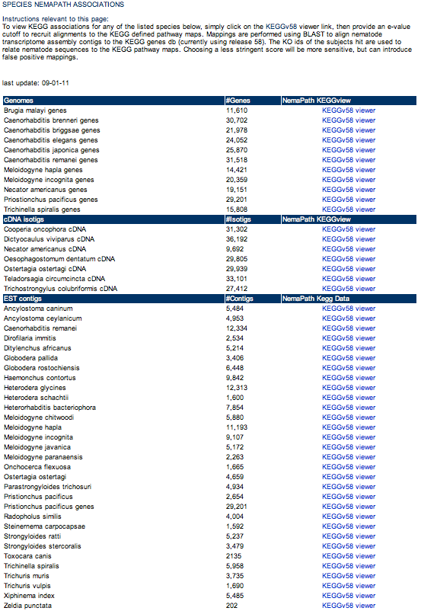
Site Overview: NemaPath Species Comparisons
20
http://nematode.net

Slide 22
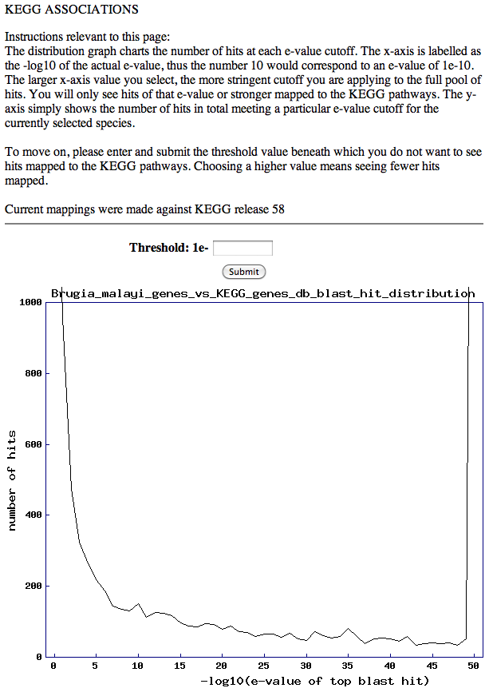
Site Overview: NemaPath Species Cutoff Selection
21
http://nematode.net

Slide 23
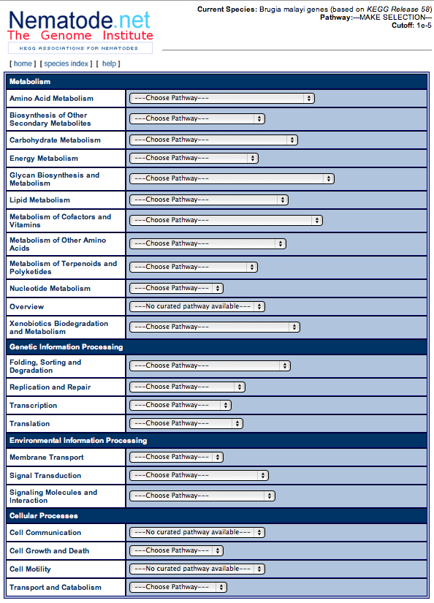
Site Overview: NemaPath Pathway Selection
22
http://nematode.net

Slide 24
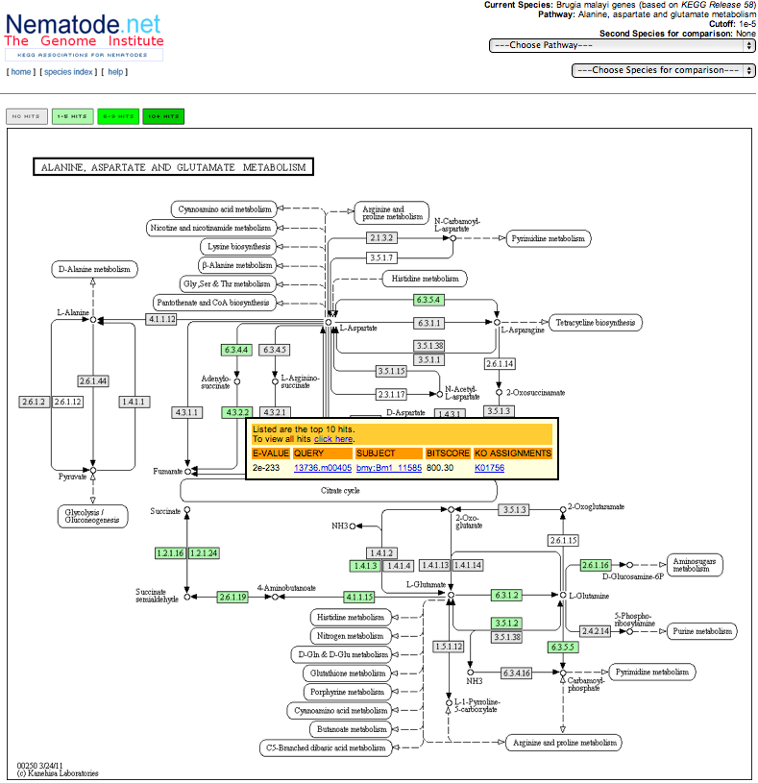
Site Overview: NemaPath Pathway Visualization
23
http://nematode.net

Slide 25
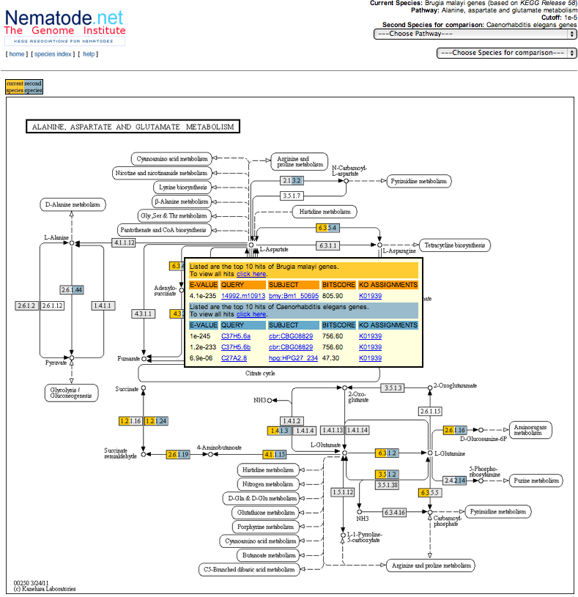
Site Overview: NemaPath Comparative View
24
http://nematode.net

Slide 26
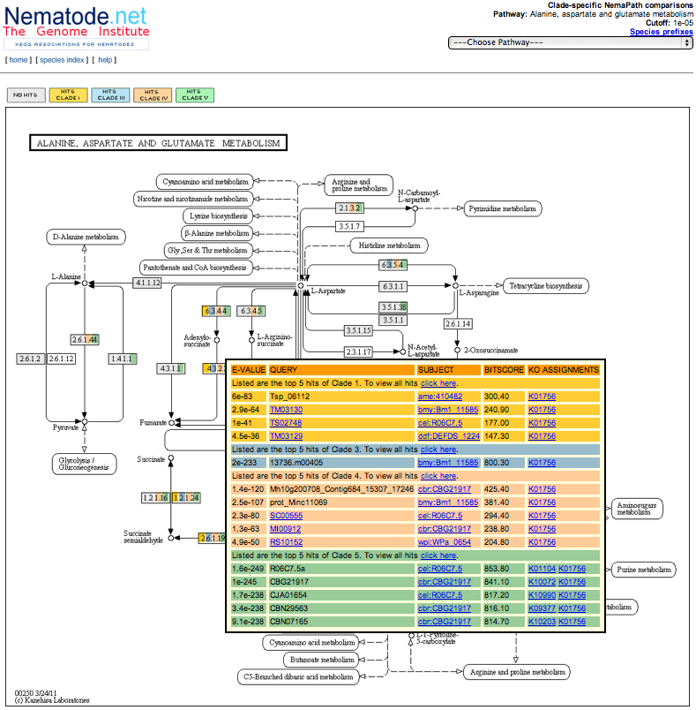
Site Overview: NemaPath Pathway Clade View
25
http://nematode.net

Slide 27
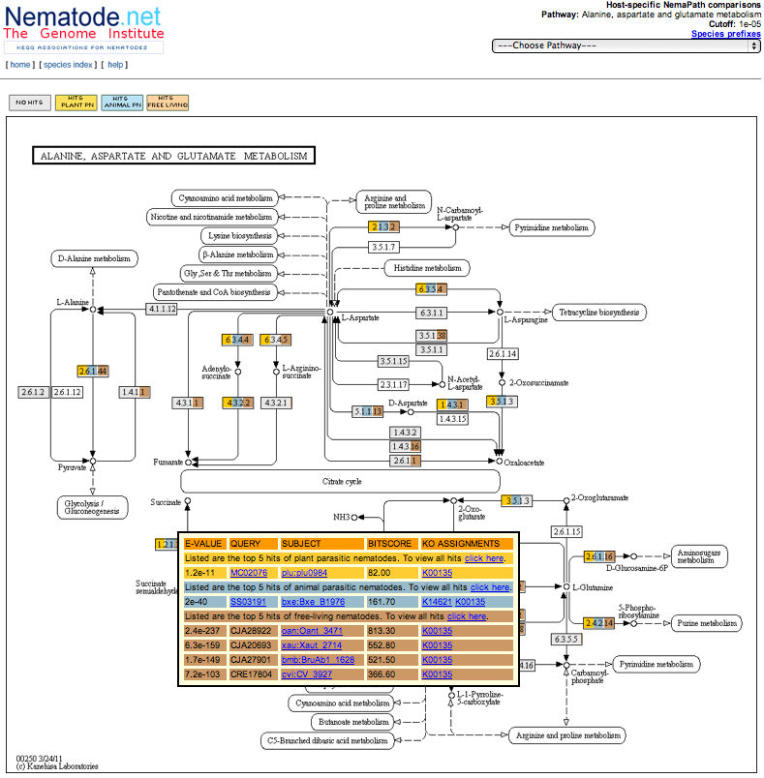
Site Overview: NemaPath Pathway Host View
26
http://nematode.net

Slide 28
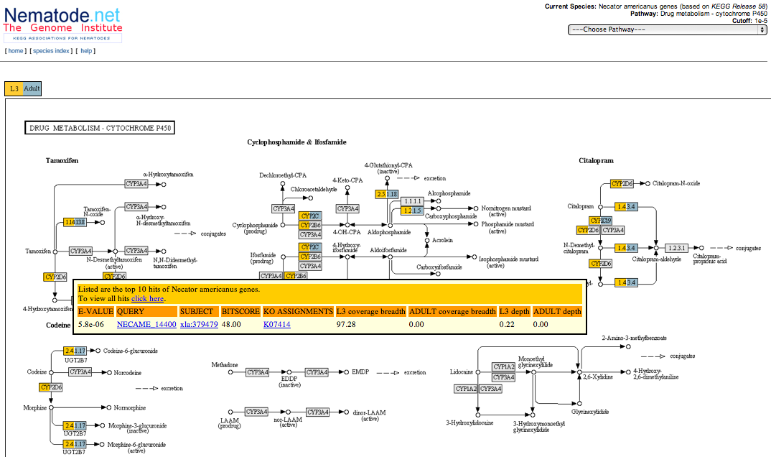
Site Overview: NemaPath Pathway Stage View
27
http://nematode.net

Slide 29
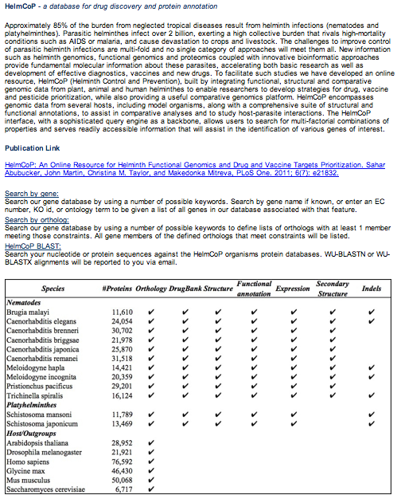
Site Overview: HelmCoP
28
http://nematode.net

Slide 30
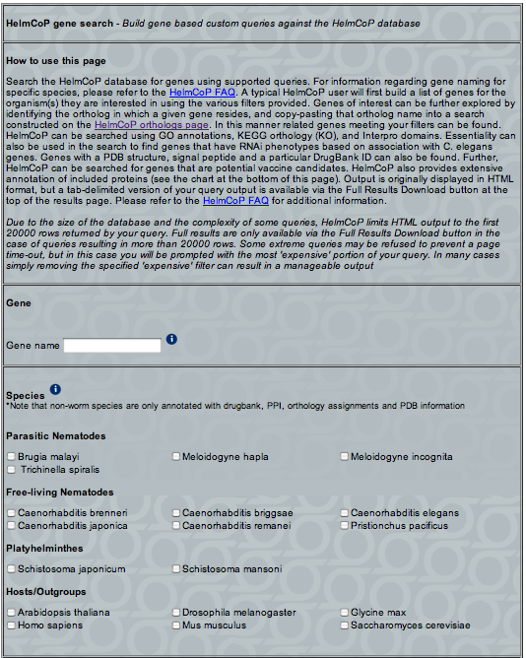
Site Overview: HelmCoP Gene Search
29
http://nematode.net

Slide 31
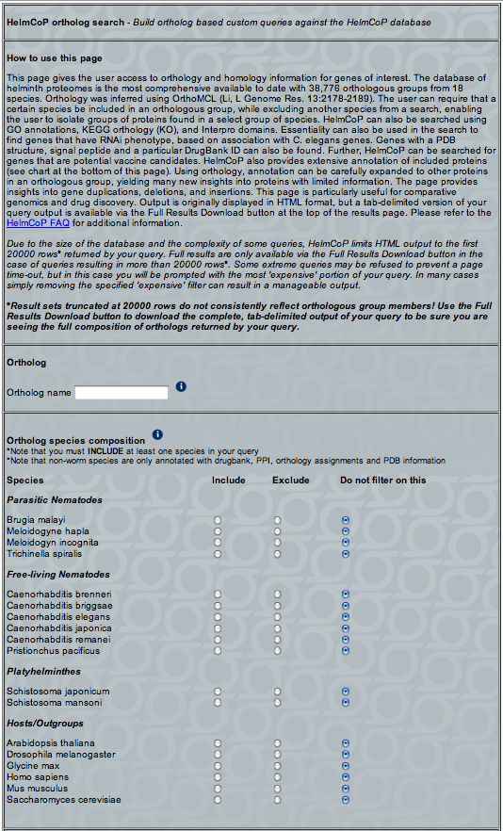
Site Overview: HelmCoP Ortholog Search
30
http://nematode.net

Slide 32
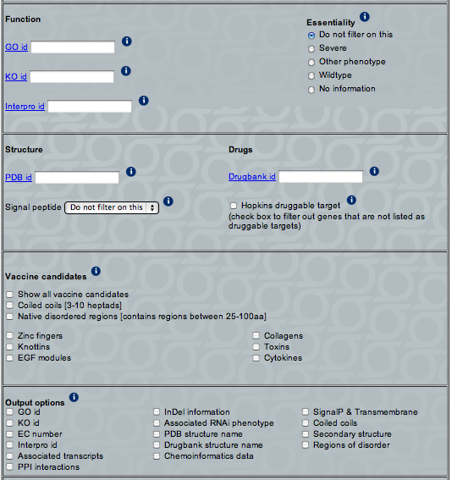
Site Overview: HelmCoP Filters & Output settings
31
http://nematode.net

Slide 33
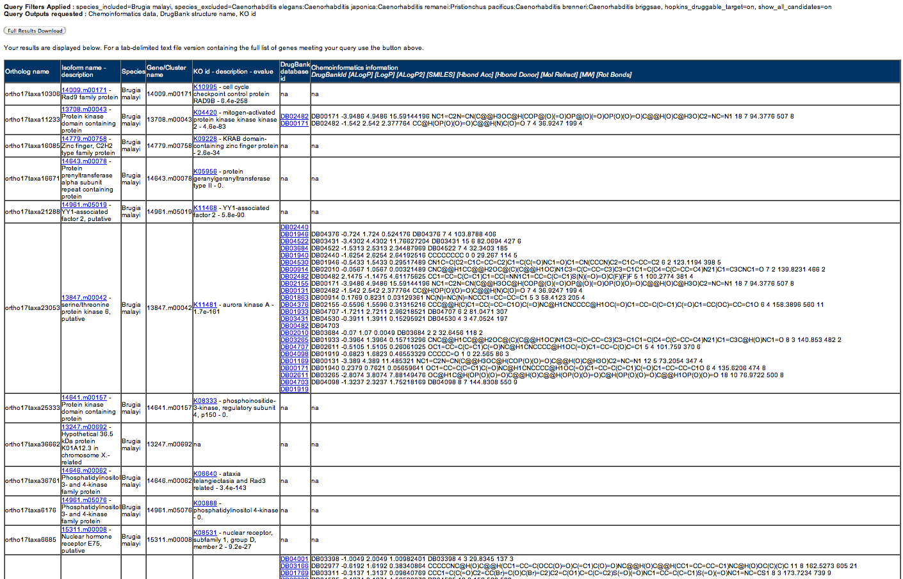
Site Overview: HelmCoP Results
32
http://nematode.net

Slide 34
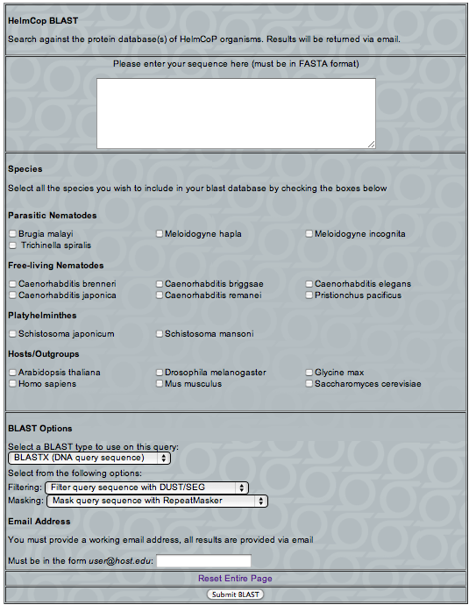
Site Overview: HelmCoP BLAST
33
http://nematode.net

Slide 35
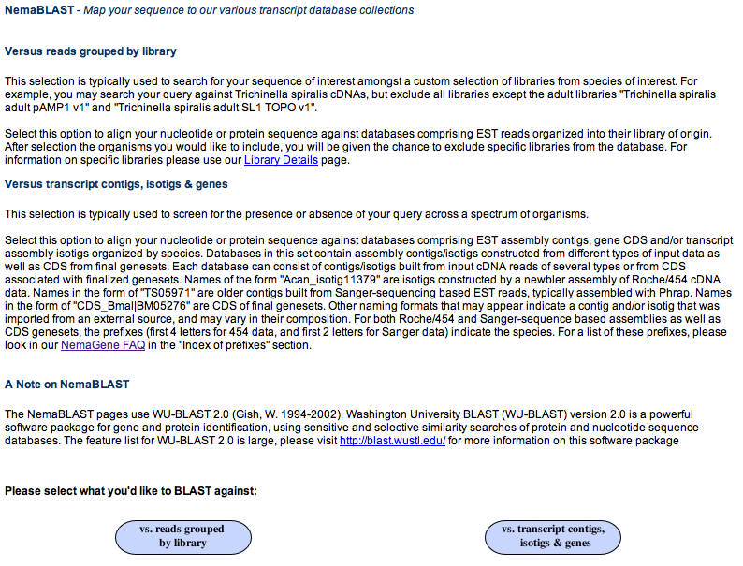
Site Overview: NemaBLAST
34
http://nematode.net

Slide 36
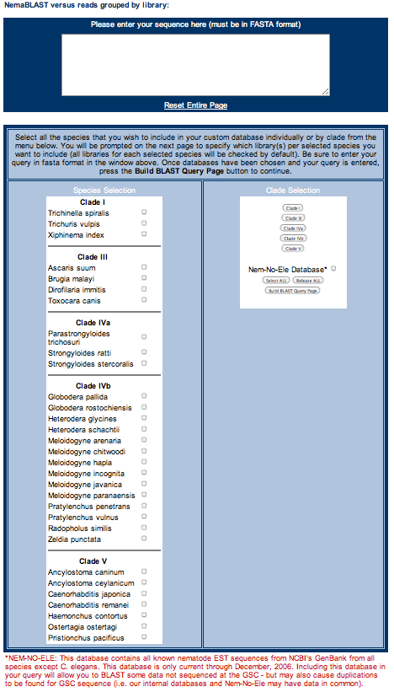
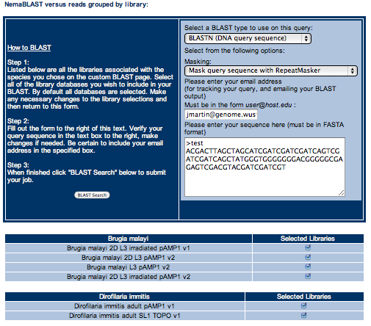
Site Overview: NemaBLAST vs Reads
35
http://nematode.net

Slide 37
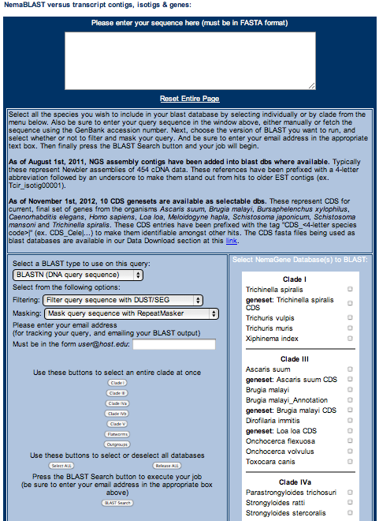
Site Overview: NemaBLAST vs Transcripts & Genes
36
http://nematode.net

Slide 38
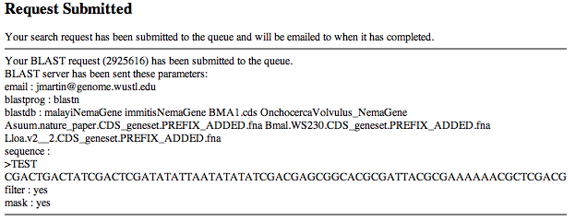
Site Overview: NemaBLAST Request Status
37
http://nematode.net

Slide 39
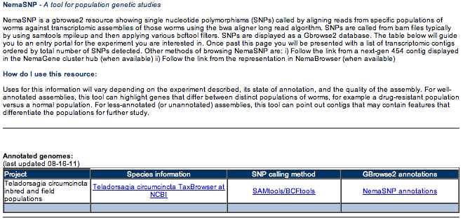
Site Overview: NemaSNP
38
http://nematode.net

Slide 40
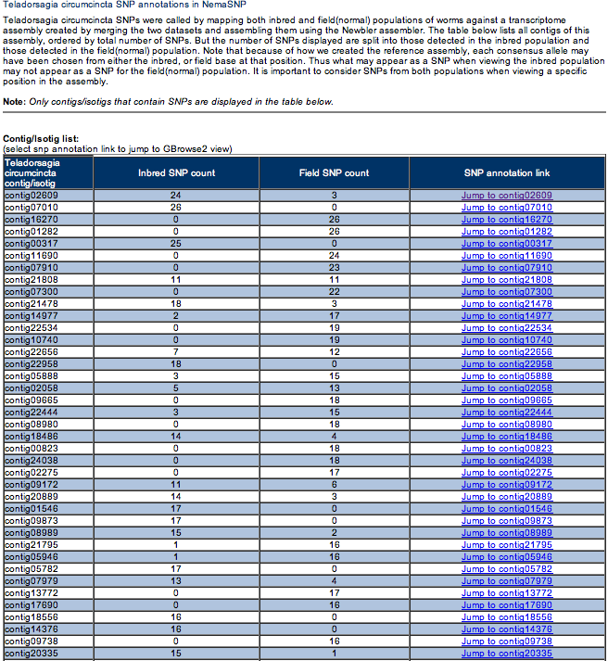
Site Overview: NemaSNP Region Selection
39
http://nematode.net

Slide 41
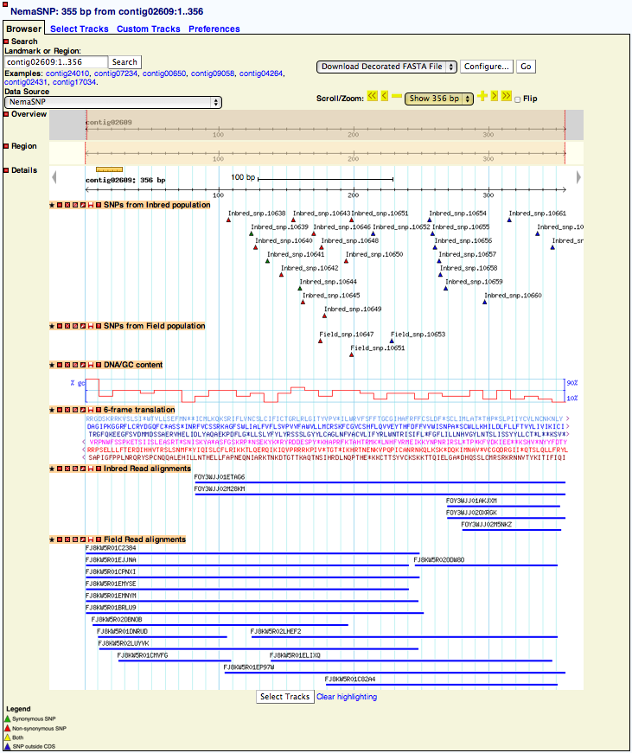
Site Overview: NemaSNP Detail View
40
http://nematode.net

Slide 42
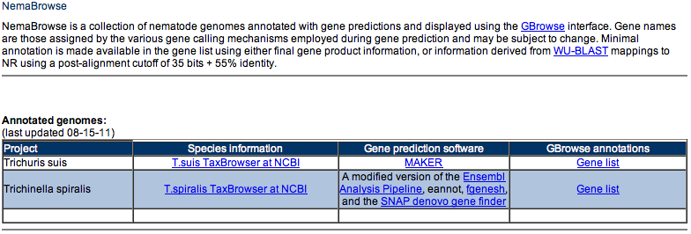
Site Overview: NemaBrowse
41
http://nematode.net

Slide 43
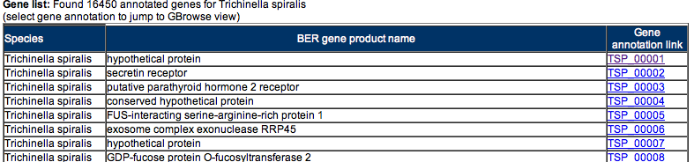
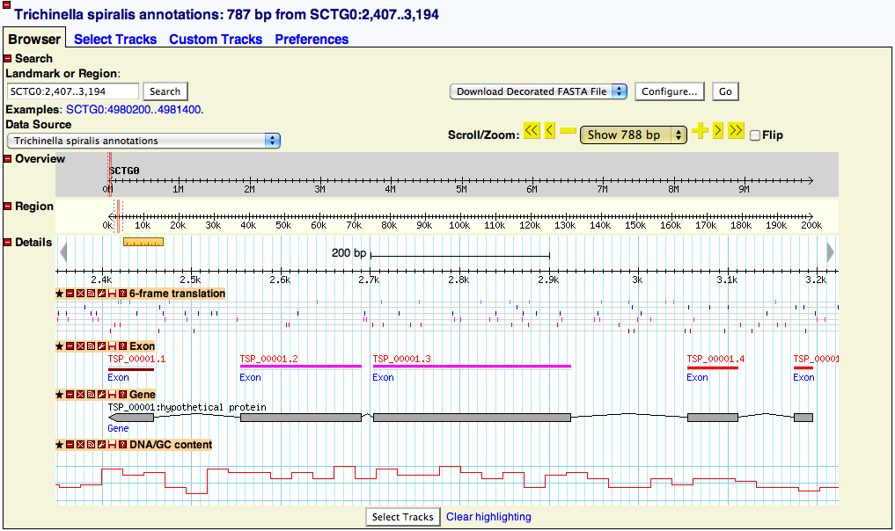
Site Overview: NemaBrowse Gene View
42
http://nematode.net

Slide 44
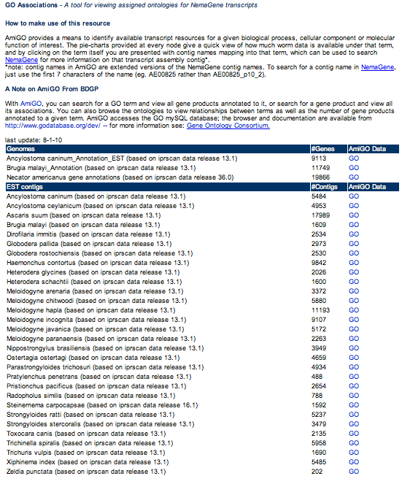
Site Overview: GO Associations
43
http://nematode.net

Slide 45
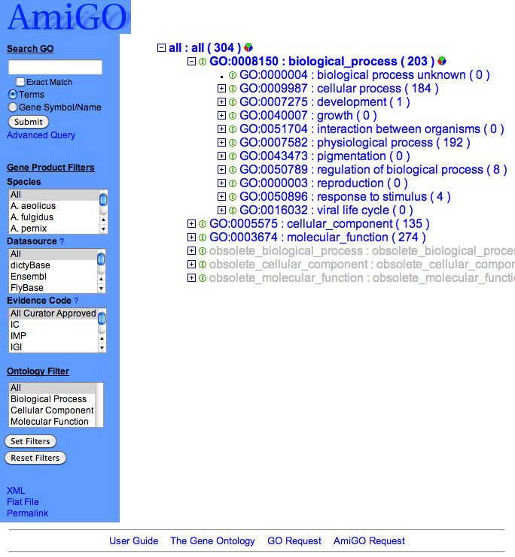
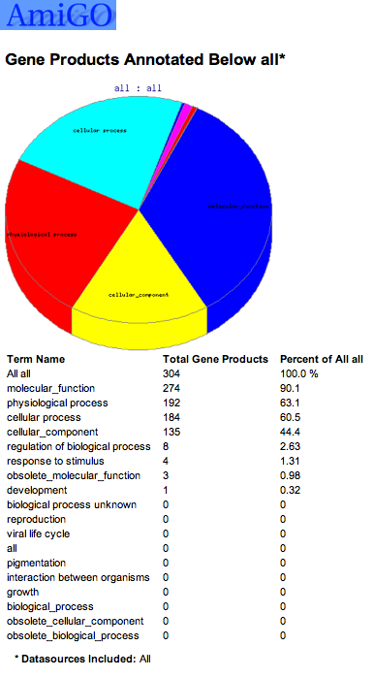
Site Overview: GO Associations AmiGO
44
http://nematode.net

Slide 46
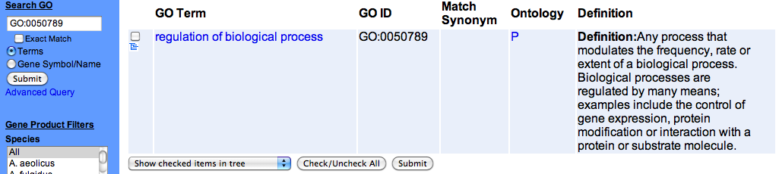
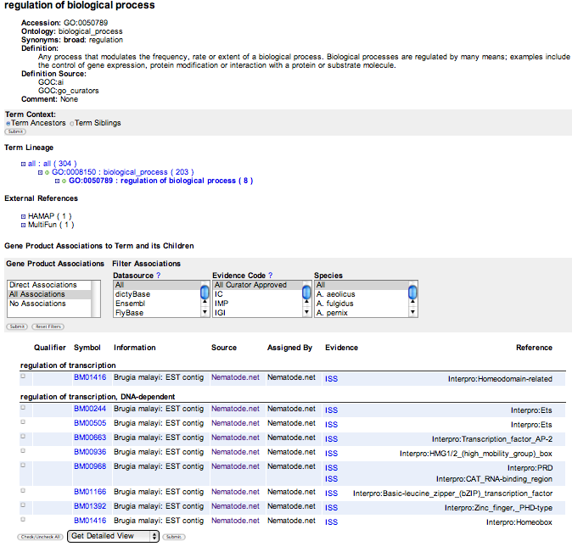
Site Overview: GO Association Term Search
Enter your GO
term here
Transcripts assigned
to this GO term
45
http://nematode.net

Slide 47

Site Overview: NemFam
There are additional
‘NemFam’ collections
not yet viewable
within the NemFam
interface
46
http://nematode.net

Slide 48


Site Overview: NemFam Advanced Search
47
http://nematode.net

Slide 49

Site Overview: NemFam View
NemFam
group
details
Legend:
-Region of disorder
-Beta sheet
-Alpha helix
-Transmembrane
-Signal peptide
-Predicted domain
48
http://nematode.net

Slide 50

Site Overview: Transcript Assembly Data
49
http://nematode.net

Slide 51
Site Overview: Isotigs & Isogroups
50
http://nematode.net

Slide 52

Site Overview: Codon Usage Tables
51
http://nematode.net

Slide 53

Site Overview: EST Cluster Data
52
http://nematode.net

Slide 54

Site Overview: Intestinal Transcriptome Data
53
http://nematode.net

Slide 55

Site Overview: Gene Expression Data
54
http://nematode.net

Slide 56

Hosted Datasets: Summary
55
http://nematode.net

Slide 57

Hosted Datasets: NemaGene
56
http://nematode.net

Slide 58



Hosted Datasets: NemaGene Related Publications
57
http://nematode.net

Slide 59

Hosted Datasets: HelmCoP
58
http://nematode.net

Slide 60

Hosted Datasets: HelmCoP Related Publications
59
http://nematode.net

Slide 61

Hosted Datasets: NemFam
60
http://nematode.net

Slide 62


Hosted Datasets: NemFam Related Publications
61
http://nematode.net

Slide 63

Hosted Datasets: Gene Expression Data
62
http://nematode.net

Slide 64





Hosted Datasets: Expression Data Related Publications
63
http://nematode.net

Slide 65

Hosted Datasets: Nematode Genomes
64
http://nematode.net

Slide 66

Hosted Datasets: Nematode Genome Related Publications
65
http://nematode.net

Slide 67

Hosted Datasets: Publication Datasets
66
http://nematode.net

Slide 68



Hosted Datasets: Several Publications With Hosted Data
67
http://nematode.net

Slide 69

Upcoming Nematode Projects
Multiple isolates from each worm
Data produced will be Illumina RNAseq
68
http://nematode.net

Slide 70

Upcoming Nematode Projects: Collaborator & Collection Sites
Figure 1. A Network of Nematologists Collaborators ( ) and Sample Collection Sites ( ).
69
http://nematode.net

Slide 71








Nematode.net Staff & Alumni
Todd Wylie
Alumni developer
Dr. Yong Yin
Alumni content provider
Sahar Abubucker
Alumni developer
Dr. Christy Taylor
Alumni content provider
John Martin
Current developer
Dr. Zhengyuan Wang
Alumni content provider
Dr. Makedonka Mitreva
Site PI
NIAID
Funding source
70
http://nematode.net

